Slide 1
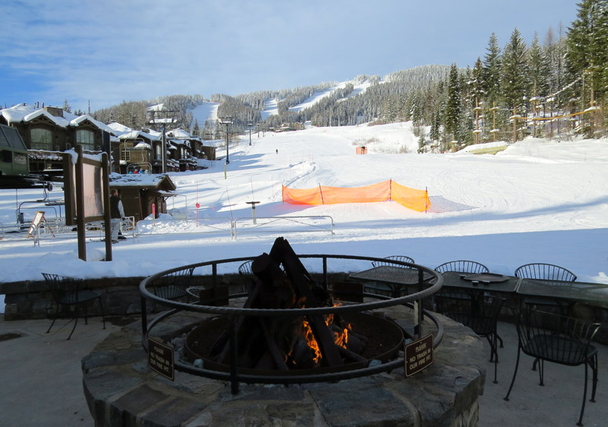
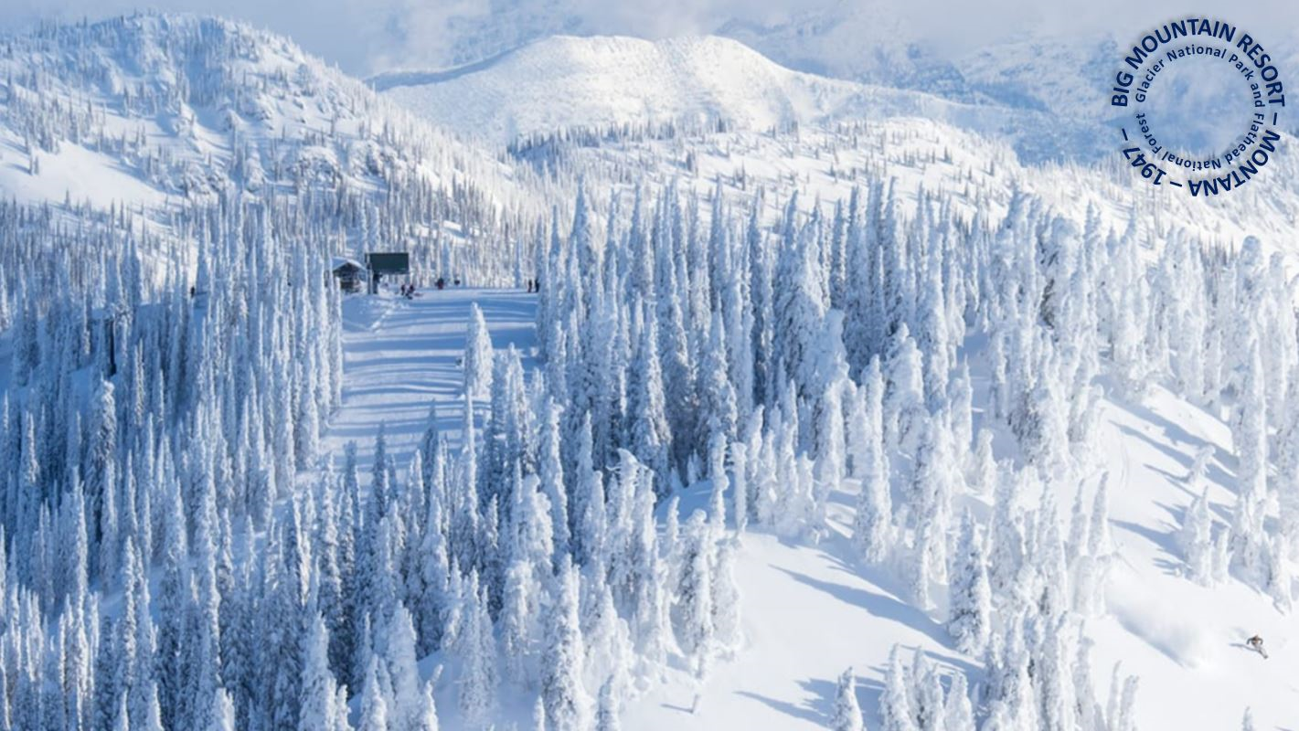
Big Mountain Ski Resort
Ticket Pricing Model
Swati Kharat(Feb2024)

Slide 2
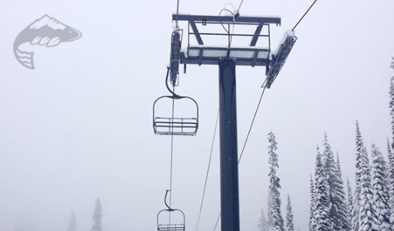
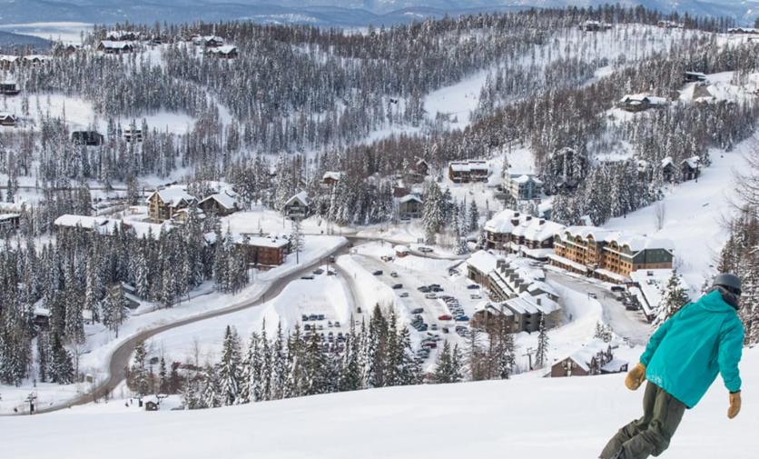
Problem Statement
What opportunities exist for Big Mountain Resort to effectively develop and implement a new pricing strategy that can maximize capitalization in their facilities investments to offset their recent additional operating cost by $1.54M this season.
Resort Story
Big Mountain Resort offers spectacular views of Glacier National Park and Flathead National Forest, with access to 105 trails. Every year about 350,000 people ski or snowboard at Big Mountain. The business expressed a desire for some guidance on how to select a better value for their ticket price. by considering number of changes hoping to reduce cost without reducing ticket price or increasing ticket price.

Slide 3
Purpose of this project
Provide guidance for pricing and future facility investment
Prepare a pricing model for ski resort tickets within their market segment.
Build a predictive model for ticket price
Number of facilities or properties at resorts
Provide insight into what facilities matter most to visitors
Which facilities they are most likely to pay for

Slide 4
Current Resort’s Pricing Strategy
For Big Mountain Resort to base their pricing mainly on just the market average won’t be enough to maximize their capitalization investment and can’t be sustainable to gain an edge over the competition.
Recommendations
Our Model suggests that Mountain Resort’s ticket price is lower than the predicted model by 16.31%, and the resort have many potential scenarios for either cutting costs by closing runs or increasing ticket price by increasing vertical drop, adding acres snow making or increasing the longest run.
Increasing the vertical drop by 150 ft would increase the ticket price by 10.44% from $81 to $89.46, resulting in revenue increase by $14,811,594.
Adding 2 acres of snow making would increase the ticket price by 12% from $81 to $90.75, resulting in revenue increase by $17,068,841.

Slide 5
Key Findings
Permanent closure of up to 10 of the least used runs
Can close upto 5 runs results in drop in ticket prices and revenue
Increase vertical drop by 150ft and addition of a chair lift
Justifies ticket price increase of $8.67 and additional revenue of $15 million
Number 2 plus the addition of 2 acres of snow making
Justifies ticket price increase of $10.59 and additional revenue of $18.5 million
Increase the longest run by 0.2 miles (boasting the longest run) and additional snow making of 4 acres
Results in no change in ticket price

Slide 6
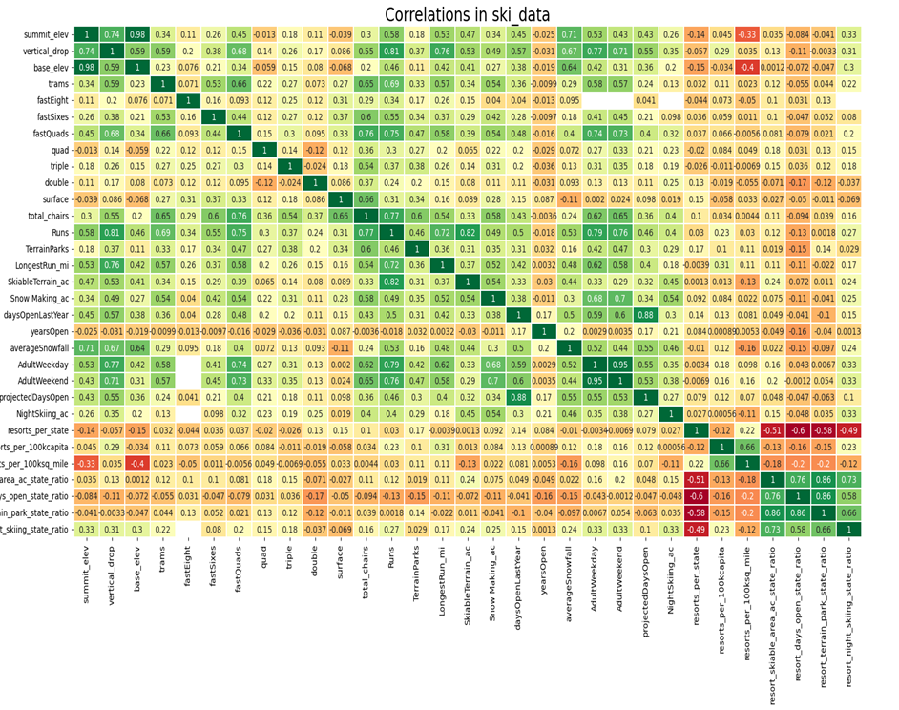
● Four features have a strong positive correlation with ticket pricing:
○ fastQuads
○ SnowMaking_Ac
○ Runs
○ Night skiing ratio

Slide 7
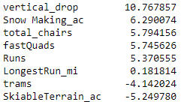
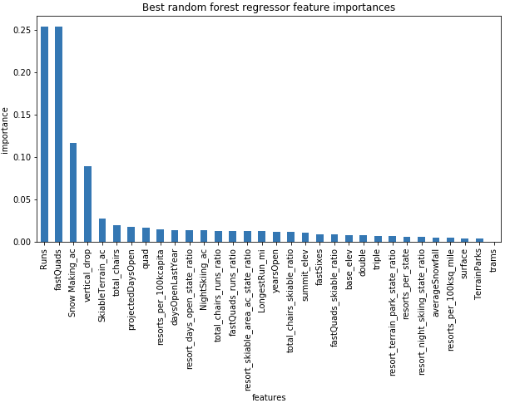
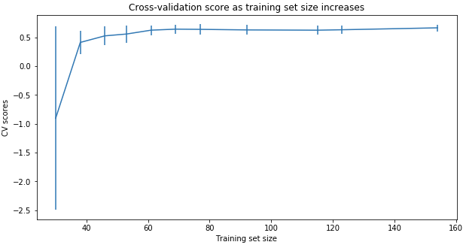
Modeling Comparison
Linear Regression Model vs. Random Forest Regression Model
( MAE, std) 10.499, 1.622 vs. 9.649, 1.505
Cross-Validation Score
Notes:
The random forest model has a lower cross-validation mean absolute error (MAE errors between paired observations expressing the same phenomenon) by almost $1. It also exhibits less variability. Verifying performance on the test set produces performance consistent with the cross-validation results. (10.499032338015294, 1.6220608976799664) vs. (9.649477185159107, 1.505326312688125)
This shows that you seem to have plenty of data. There's an initial rapid improvement in model scores as one would expect, but it's essentially levelled off by around a sample size of 40-50

Slide 8
Modeling Data
Modelled price is $95.86 vs. actual price $81.00
MAE = $10.36 suggests there is room for an increase
Pricing Assumptions
Other resorts set their prices according to the market
Big Mountain appears to be charging much less than prediction suggests
Is Big Mountain undercharging?
Are other resorts overpriced?
Is our model lacking some key data
Operating Costs

Slide 9
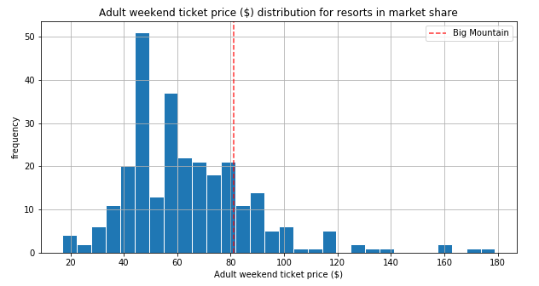
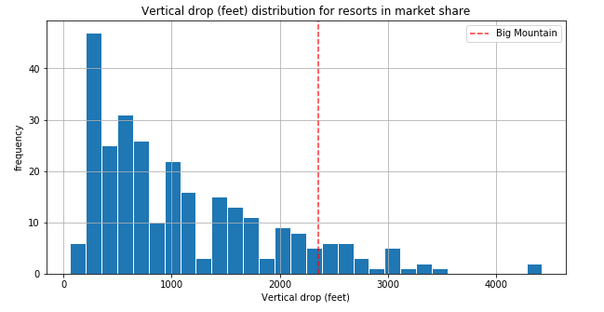
Big Mountain’s Ticket Price compared to other Resorts Ticket Price.
Big Mountain is doing well for vertical drop but there are still quite a few resorts with a greater drops.

Slide 10
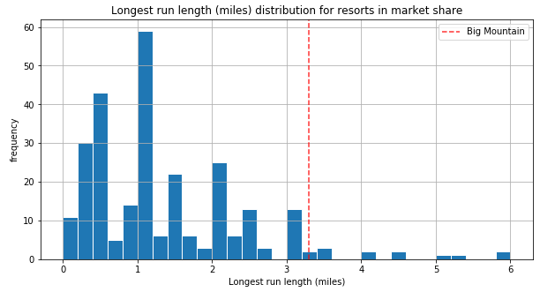
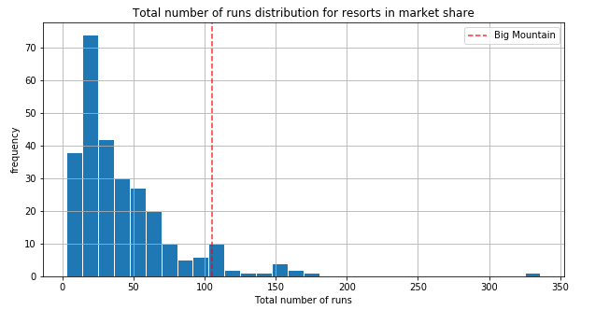
Big Mountain has one of the longest runs. Although it is just over half the length of the longest, the longer ones are rare.
Big Mountain compares well for the number of runs. There are some resorts with more, but not many.

Slide 11
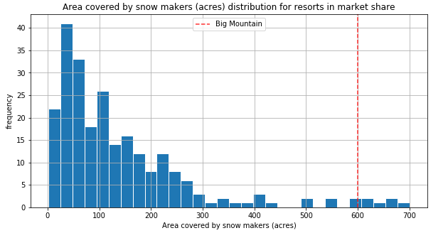
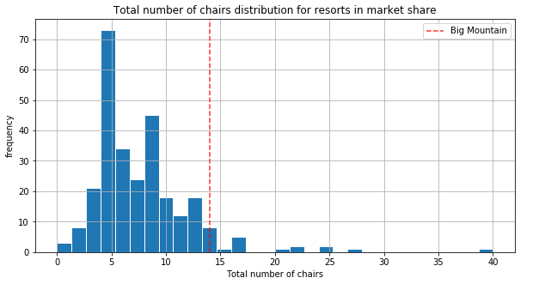
Big Mountain is very high up the league table of snow making area.
Big Mountain has amongst the highest number of total chairs, resorts with more appear to be outliers.

Slide 12
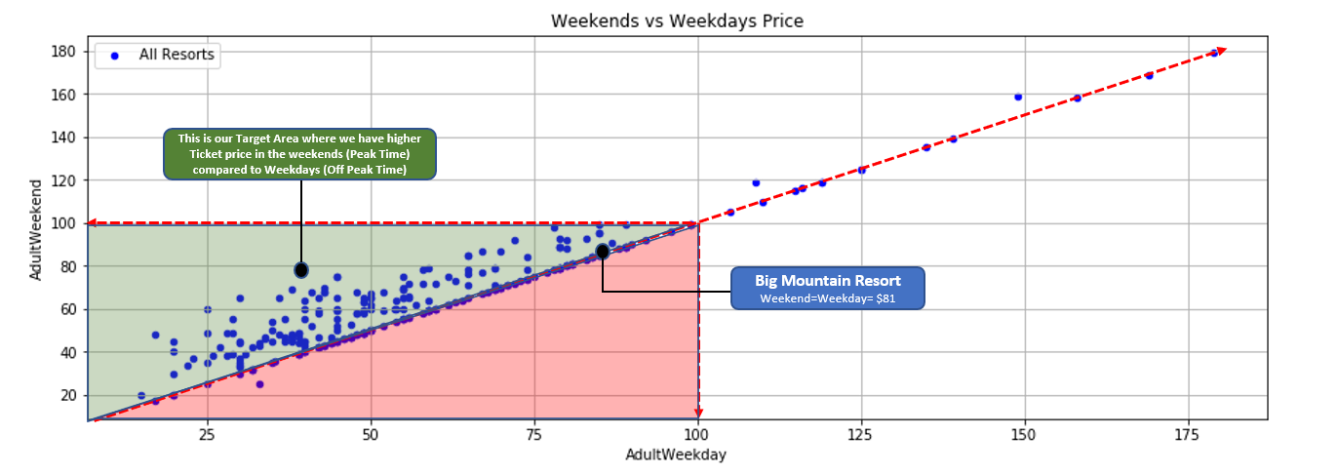
Main Data Source Limitation
Our main data source is missing some important information like:
Weekdays ticket price (Missing Information) and
Operating costs for most of the resorts features (e.g., Runs operating cost is missing).
So in order for our model to provide a better price prediction it would be beneficial if we can get another source of data
Dynamic Pricing: Weekdays vs Weekends Ticket Price
One of the pricing Strategy we could recommend to Big Mountain Resort is to develop and implement a DYNAMIC pricing; by having a higher ticket prices during the weekends where they have higher number of visitors and a lower ticket prices during the weekdays where they have a lower number of visitors (To attract more visitors).
As shown to the left, most of the US Resorts already implemented a Dynamic Pricing Strategy

Slide 13
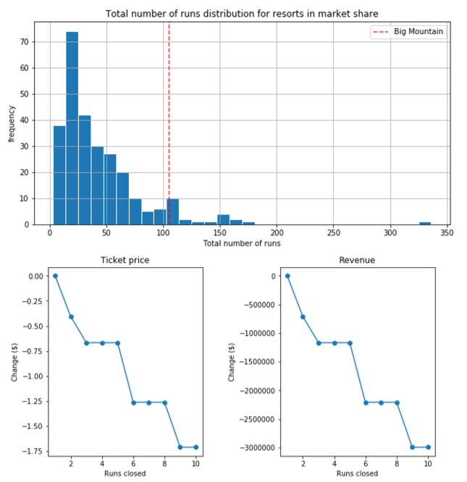
Closing up to 10 Runs vs (Ticket price & Revenue)
Big Mountain Resort has been reviewing a potential scenario for cutting costs by Permanently closing down up to 10 of the least used runs.
Our Model predicted the following when it comes to closing up to 10 used Runs:
Closing one run will have no impact on Ticket price or revenue.
Closing 2 runs reduce support for ticket price and so revenue by $0.4 and $750,000 respectively.
Closing down 3 runs, it seems they may as well close down 4 or 5 as there’s same loss in ticket price and revenue by $0.67 and $1.250M respectively.
Closing 10 runs reduce support for ticket price and so revenue by $1.71 and $3M respectively.
Because we don’t know the operating cost per used run, we can’t determine how much cost saving will be offset the loss in revenue after closing more than one run.

Slide 14
Summary
Big Mountain Currently ranks among the top resorts
Skiable terrain
Number of Runs
Snow making capacity
Number of Chairs
Proposed Scenerios
Closure of 5 least used runs
Increase vertical drop with and without snowmaking
Increase longest run with snowmaking
By increasing the vertical drop either with or without snowmaking will provide the opportunity to increase revenues by $15-$18 million, however the increase cost of tickets must be considered.

Slide 15
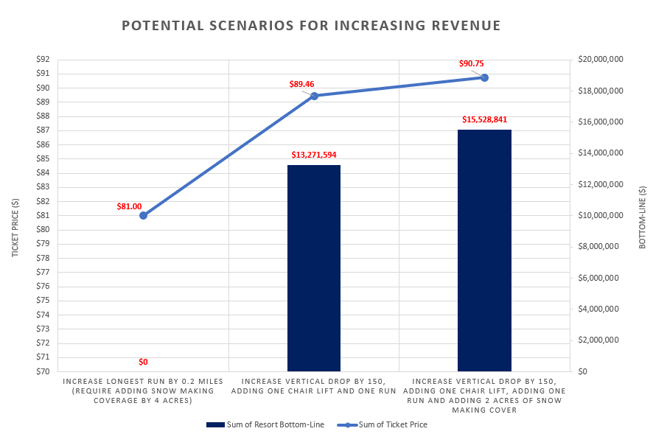
Conclusion
After applying our Model for ski resort ticket price and leverage it to explore Big Mountain Resort’s potential scenarios for increasing revenue, we can conclude that:
The best scenario where we managed to gain the highest revenue increase possible was by increasing the vertical drop by 150 ft, adding one Chair Lift, adding one run and adding 2 acres of snow making cover. This scenario has increased ticket price by 12% from $81 to $90.75, resulting in a bottom-line increase by $15,528,841 (After deducting operating costs = $1.54M).
Due to lack of data in regards of operating cost per used run and weekdays ticket price, our model cannot recommend closing down used runs or implementing a dynamic ticket pricing.
This Scenario resulted in no revenue increase

